Slide 1
Handware study
on distributed multi-robot system
Aixi Guo
Oct 13, 2018

Slide 2
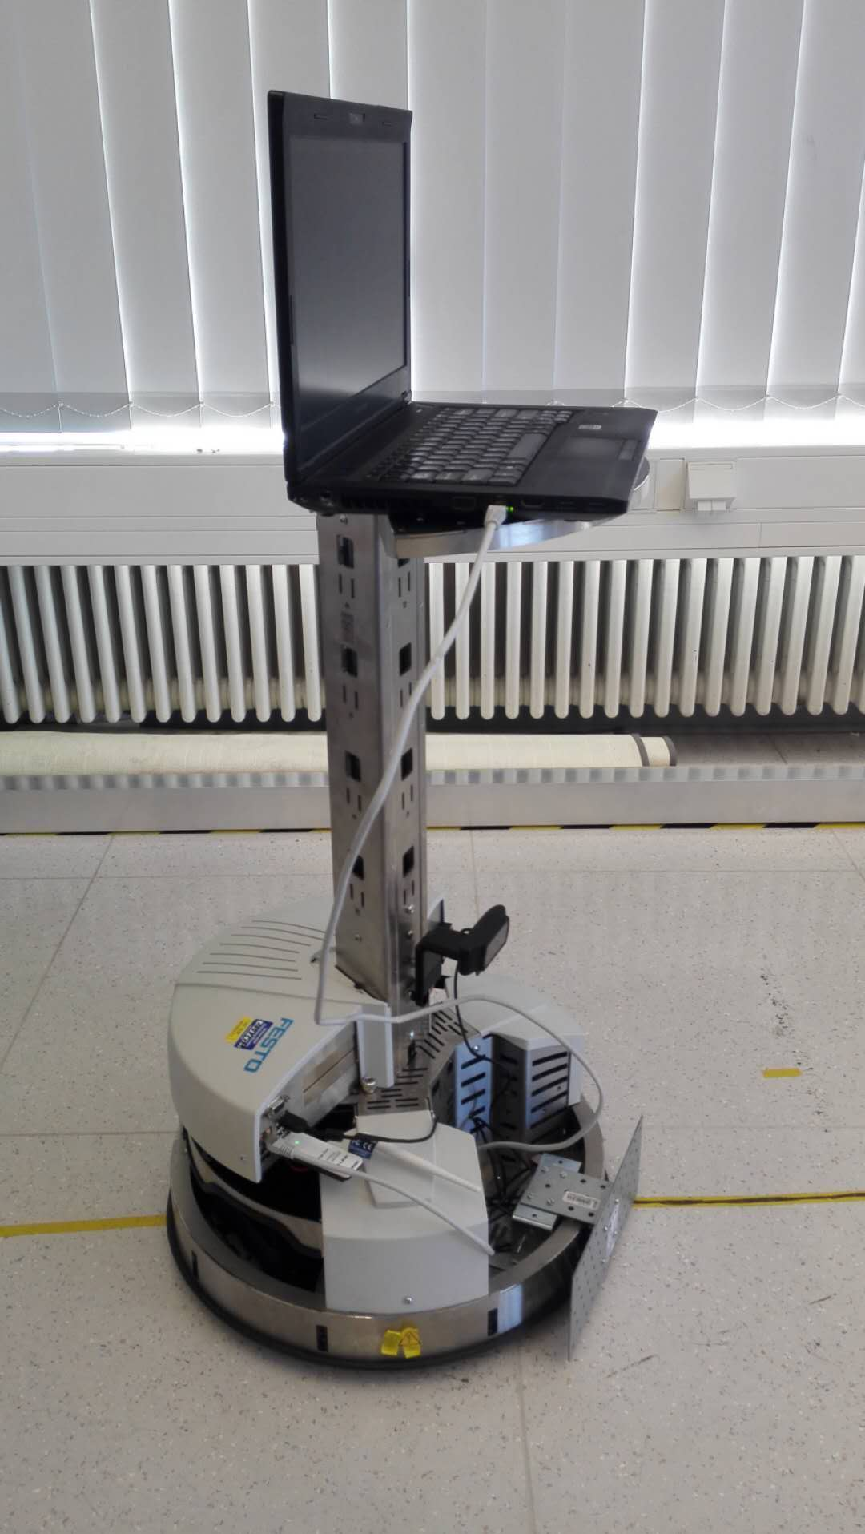
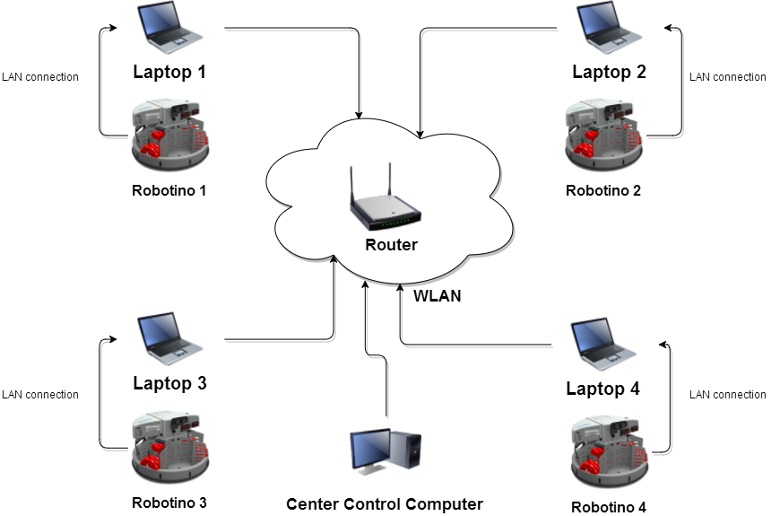
Hardware Connection Plan
- Plan A: Robotino with laptop
Notes:
Each robot connect with a laptop using lan cable.
Laptop accesses the local network which is create by a router using WiFi.
Laptop could run the program to control the robot. And it can communicate with other laptop in the same local network at the same time.

Slide 3
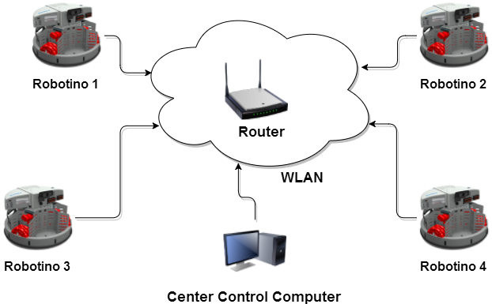
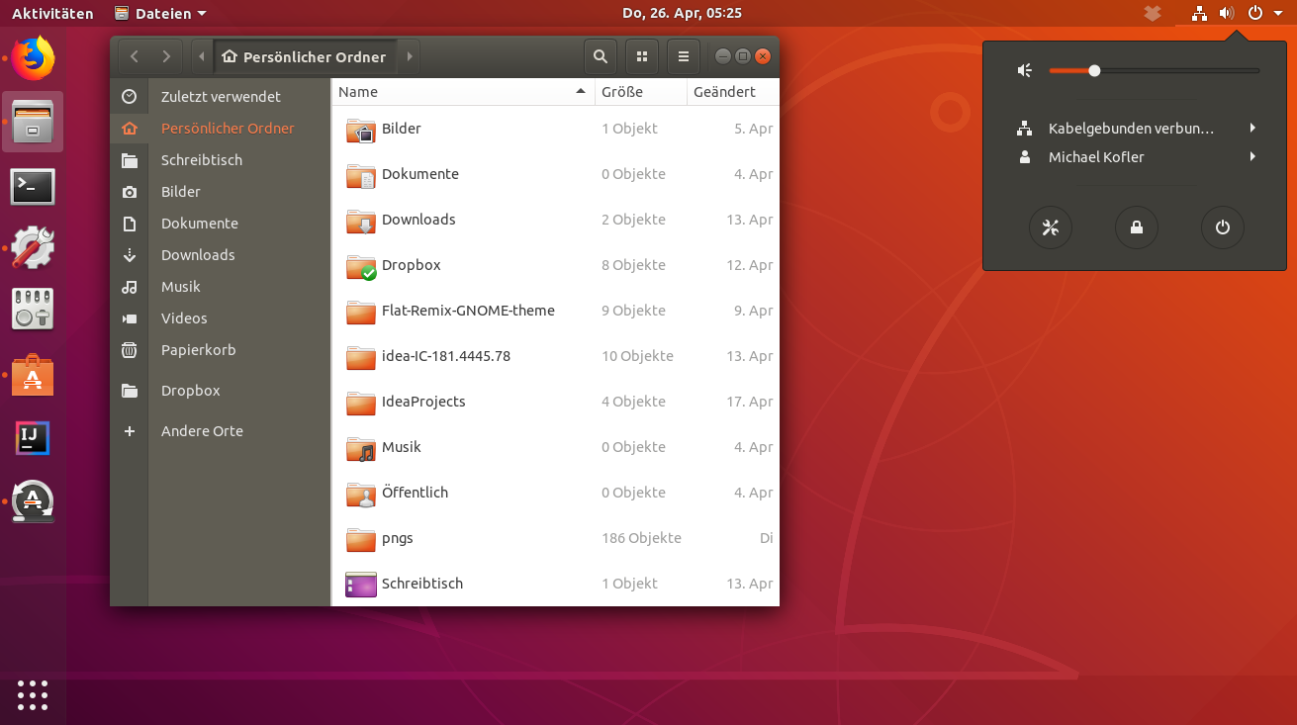
Hardware Connection Plan
- Plan B: Robotino without laptop
Notes:
Write program directly on the Robotino’s system.
Robotino has a Ubuntu Linux operate system. We could directly write program on it.
Robotino needs add a wireless module so that it could access the wireless local network.

Slide 4
Hardware Connection Plan
Comparision
Plan A needs extra laptops for each Robot.
Plan A can support more software.
Plan A is 50–100 times faster than Plan B when using GPU for image processing*
Plan B has the simple hardware structure.
Plan B costs more less.
Plan B needs transform current platform to linux.
Support Software | Plan A | Plan B
MATLAB/Simulink | Yes | No
C++&OpenCV | Yes | Yes
Unity | Yes | No
Robotino View | YES | YES
Support Technologie
Robot Control | Yes | Faster
Image Process | Faster And Advance | Slow And Basic
Cooperation | Yes | Yes
*https://medium.com/altumea/gpu-vs-cpu-computing-what-to-choose-a9788a2370c4
Notes:
Laptop could run all kind of software, especially MATLAB , SIMULINK, UNITY ….
Laptop could do the Image Process faster 50-100 times , because it has GPU module.
Without Laptop we could also write the program. But we need to change the platform, Current we use C++ + OpenCV to do the Control and Image Process. On Linux it is also support c++ and openCV. But we need to change the platform to Linux, and reprogram.
Without Laptop we could have simple hardware structure. And it costs of course less.

Slide 5
Distrubute System For Robot
Distrubute System For Robot
No matter which kind of hardware plan is choice, we need a distribute system for robot. This distribute system handles following tasks:
Build up a local network.
Transmission data through the network.
Physical data: position, speed, distance…
Command data: start to move, stop, setting target…
Supply interface for other project.
toolbox for matlab.
C/C++ function interface.
Notes:
No matter which kind of hardware plan is choice, we need a distribute system for robot.
Distribute system is a application use for Robot to build up the connections amount the robots. It is also responsible for transmitting/receiving data. Code/decode the command, and so on
Distribute system is independent on other application. That means, it will not interrupt the other project. I will also design the interface for other application. Design a Matlab toolbox, and C/C++ function interface.

Slide 6

Distrubute System For Robot
Distrubute System For Robot Example
PC2
PC1
Wireless Network
Notes:
Example.
Put a Laptop on the robot. Laptop connect with robot using lan cable. This computer access the local wireless network.
There is another computer which is also access the same wireless network.
PC2 can send a rotation command to PC1, PC1 will control the robot to do the rotation.

Slide 7
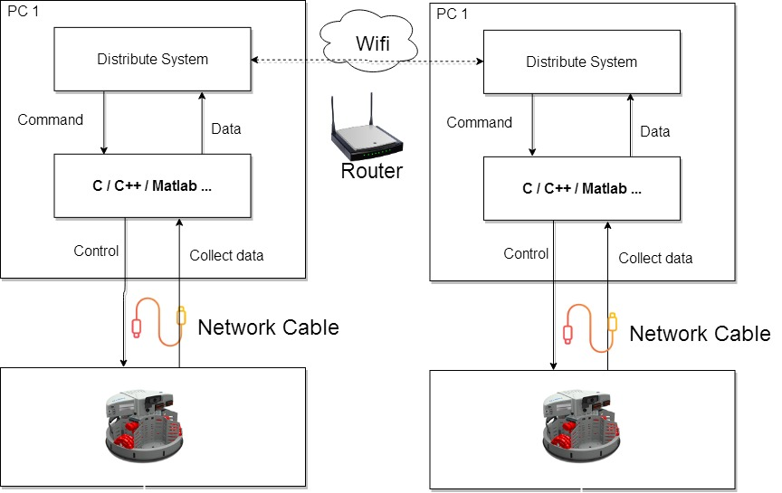
Distrubute System For Robot
Notes:
This is the program structure on the PC1.
C/C++/Matlab is responsible for control and collect data from robot
Distrubute System is responsible for receive remote Data and send corresponding command to the bottom layer.

Slide 8
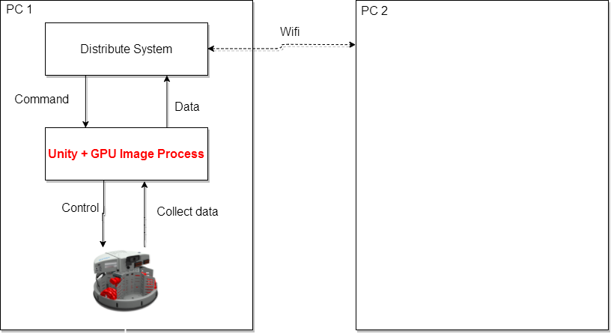
Distrubute System For Robot
Topic: Distrubute control base on image process
Notes:
My topic is to design a distribute control for the robot. So that they can cooperate with each other.
To do this, I need to use the Image Process to get the location of the Robot. And second part is I need the Distribute System to communicate with other PC.

Slide 9
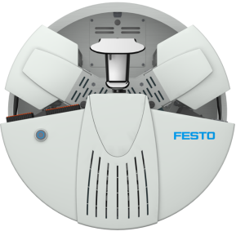
Distrubute Control Example
target
1
2
3
1
1
2
3
1
target
3
2
3
2
target

Slide 10
Thank you for your valuable time
and your attention.

